Slide 1
FIRST ORDER LOGIC AND PROLOG

Slide 2
First-order logic
First-order logic is another way of knowledge representation in artificial intelligence. It is an extension to propositional logic.
FOL is sufficiently expressive to represent the natural language statements in a concise way.
First-order logic is also known as Predicate logic or First-order predicate logic. First-order logic is a powerful language that develops information about the objects in a more easy way and can also express the relationship between those objects.

Slide 3
First-order logic (like natural language) does not only assume that the world contains facts like propositional logic but also assumes the following things in the world:
Objects: A, B, people, numbers, colors, wars, theories, squares, pits, wumpus
Relations: It can be unary relation such as: red, round, is adjacent, or n-any relation such as: the sister of, brother of, has color, comes between
Function: Father of, best friend, third inning of, end of, ......
As a natural language, first-order logic also has two main parts:
Syntax
Semantics

Slide 4
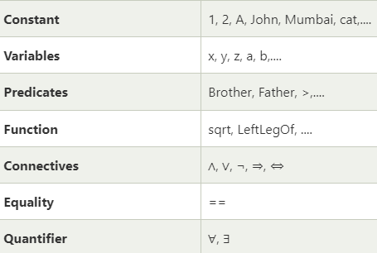
Syntax of First-Order logic:
The syntax of FOL determines which collection of symbols is a logical expression in first-order logic. The basic syntactic elements of first-order logic are symbols. We write statements in short-hand notation in FOL.
Basic Elements of First-order logic:
Following are the basic elements of FOL syntax:

Slide 5
Atomic sentences:
Atomic sentences are the most basic sentences of first-order logic. These sentences are formed from a predicate symbol followed by a parenthesis with a sequence of terms.
We can represent atomic sentences as Predicate (term1, term2, ......, term n).
Example: Ravi and Ajay are brothers: => Brothers(Ravi, Ajay). Chinky is a cat: => cat (Chinky).
Complex Sentences:
Complex sentences are made by combining atomic sentences using connectives.
First-order logic statements can be divided into two parts:
Subject: Subject is the main part of the statement.
Predicate: A predicate can be defined as a relation, which binds two atoms together in a statement.

Slide 6
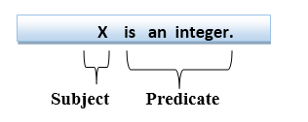
Consider the statement: "x is an integer.", it consists of two parts, the first part x is the subject of the statement and second part "is an integer," is known as a predicate.

Slide 7
Quantifiers in First-order logic:
A quantifier is a language element which generates quantification, and quantification specifies the quantity of specimen in the universe of discourse.
These are the symbols that permit to determine or identify the range and scope of the variable in the logical expression. There are two types of quantifier:
Universal Quantifier, (for all, everyone, everything)
Existential quantifier, (for some, at least one).
Universal Quantifier:
Universal quantifier is a symbol of logical representation, which specifies that the statement within its range is true for everything or every instance of a particular thing.
The Universal quantifier is represented by a symbol ∀, which resembles an inverted A.

Slide 8
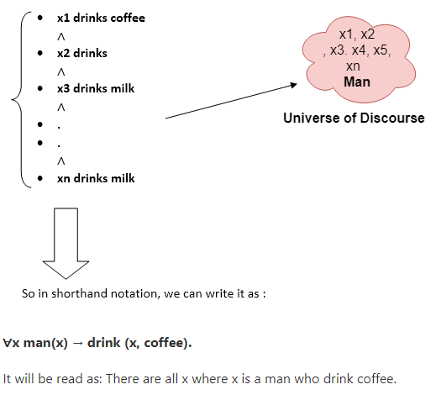
If x is a variable, then ∀x is read as:
For all x
For each x
For every x.
Example:
All man drink coffee.

Slide 9
Existential Quantifier:
Existential quantifiers are the type of quantifiers, which express that the statement within its scope is true for at least one instance of something.
It is denoted by the logical operator ∃, which resembles as inverted E. When it is used with a predicate variable then it is called as an existential quantifier.
If x is a variable, then existential quantifier will be ∃x or ∃(x). And it will be read as:

Slide 10
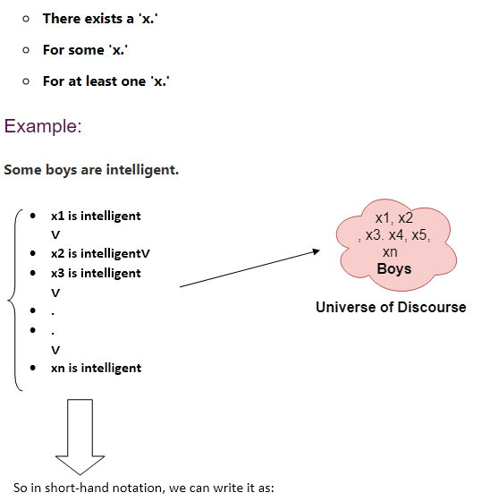
If x is a variable, then existential quantifier will be ∃x or ∃(x). And it will be read as:

Slide 11
Rule Based Expert Systems
What is knowledge?
It is a theoretical or practical understanding of a subject or a domain.
It is also the sum of what is currently known, and apparently knowledge is power. Those who possess knowledge are called experts.
It anyone can be considered a domain expert if he or she has deep knowledge and strong practical experience in a particular domain.
It is the human mental process is internal, and it is too complex to be represented as an algorithm
However, most experts are capable of expressing their knowledge in the form of rules for problem solving.
IF the ‘traffic light’ is ‘green’
THEN the action is go
IF the ‘traffic light’ is ‘red’
THEN the action is stop

Slide 12
Rules as a Knowledge Representation Technique
The term rule in AI, which is the most commonly used type of knowledge representation, can be defined as an IF-THEN structure that relates given information or facts in the IF part to some action in the THEN part.
A rule provides some description of how to solve a problem.
Rule are relatively easy to create and understand
Any rules consists of two parts: the IF part, called the antecedent (premise or condition) and the THEN part called the consequent (conclusion or action)
IF < antecedent>
THEN < consequent >

Slide 13
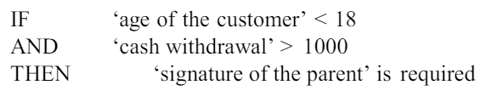
A rule can have multiple antecedents joined by the keywords AND (conjunction), OR (disjunction) or a combination of both.
IF < antecedent1> IF
AND < antecedent2> OR < antecedent2>
AND < antecedentn> OR < antecedentn>
THEN < consequent > THEN < consequent >
The antecedent of a rule incorporates two parts: an object (linguistic object) and its value. The object and its value are linked by an operator.
The operator identifies the object and assigns the value. Operators such as is, are, is not, are not are used to assign a symbolic value to a linguistic object.
Expert systems can also used mathematical operators to define an object as numerical and assign it to the numerical value.

Slide 14
Rules can represent:
Relation: IF the ‘fuel tank’ is empty THEN the car is dead
Recommendation: IF the season is autumn AND the sky is cloudy AND the forecast is drizzle THEN the advice is ‘take an umbrella’
Directive: IF the car is dead AND the ‘fuel tank’ is empty THEN the action is ‘refuel the car’
Strategy: IF the car is dead THEN the action is ‘check the fuel tank’; step1 complete IF step1 is complete AND the ‘fuel tank’ is full THEN the action is ‘check the battery’; step2 is complete
Heuristic: IF the spill is liquid AND the ‘spill pH’ < 6 AND the ‘spill smell’ is vinegar THEN the ‘spill material’ is ‘acetic acid’

Slide 15
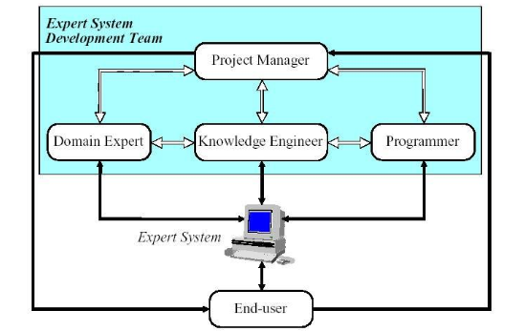
The main players in the development team
There are five members of the expert system development team:
domain expert
knowledge engineer
programmer
project manager
end-user

Slide 16
Domain Expert
It is a knowledgeable and skilled person capable of solving problems in a specific area or domain
the person’s expertise is to be captured in the expert system
could be more than one expert that contribute to an expert system
the expert must be able to communicate his or her knowledge, be willing to participate in the expert system development and commit a substantial amount of time to the project
It is the most important person in the expert system development team

Slide 17
Knowledge Engineer
It is someone who is capable of designing, building and testing an expert system
interviews the domain expert to find out how a particular problem is solved
establishes what reasoning methods the expert uses to handle facts and rules and decides how to represent them in the expert system
choose some development software or an expert systems shell, or look at programming languages for encoding the knowledge
responsible for testing, revising and integrating the expert system into the workplace

Slide 18
Programmer:
It is the person responsible for the actual programming, describing the domain knowledge in terms that a computer can understand.
needs to have the skills in symbolic programming in such AI language such as Prolog.
It should also know conventional programming language like C, Pascal, FORTRAN and Basic Project
Manager:
It is the leader of the expert system development team, responsible for keeping the project on track
It makes sure that all deliverables and milestones are met, interacts with the expert, knowledge engineer, programmer and end-user

Slide 19
End-user:
often called the user
It is a person who uses the expert system when it is developed
It must not only be confident in the expert system performance but also feel comfortable using it

Slide 20
Reasoning and Planning
Reasoning:
The reasoning is the mental process of deriving logical conclusion and making predictions from available knowledge, facts, and beliefs. Or we can say, "Reasoning is a way to infer facts from existing data."
It is a general process of thinking rationally, to find valid conclusions.
In artificial intelligence, the reasoning is essential so that the machine can also think rationally as a human brain, and can perform like a human.

Slide 21
Types of Reasoning
In artificial intelligence, reasoning can be divided into the following categories:
Deductive reasoning
Inductive reasoning
Abductive reasoning
Common Sense Reasoning
Monotonic Reasoning
Non-monotonic Reasoning

Slide 22
Deductive reasoning:
Deductive reasoning is deducing new information from logically related known information. It is the form of valid reasoning, which means the argument's conclusion must be true when the premises are true.
Deductive reasoning is a type of propositional logic in AI, and it requires various rules and facts. It is sometimes referred to as top-down reasoning, and contradictory to inductive reasoning.
In deductive reasoning, the truth of the premises guarantees the truth of the conclusion.
Deductive reasoning mostly starts from the general premises to the specific conclusion, which can be explained as below example.

Slide 23

Example:
Premise-1: All the human eats veggies
Premise-2: Suresh is human.
Conclusion: Suresh eats veggies.
The general process of deductive reasoning is given below:

Slide 24

Inductive Reasoning:
Inductive reasoning is a form of reasoning to arrive at a conclusion using limited sets of facts by the process of generalization. It starts with the series of specific facts or data and reaches to a general statement or conclusion.
Inductive reasoning is a type of propositional logic, which is also known as cause-effect reasoning or bottom-up reasoning.
In inductive reasoning, we use historical data or various premises to generate a generic rule, for which premises support the conclusion.
In inductive reasoning, premises provide probable supports to the conclusion, so the truth of premises does not guarantee the truth of the conclusion. Example:
Premise: All of the pigeons we have seen in the zoo are white.
Conclusion: Therefore, we can expect all the pigeons to be white.

Slide 25
Abductive reasoning:
Abductive reasoning is a form of logical reasoning which starts with single or multiple observations then seeks to find the most likely explanation or conclusion for the observation.
Abductive reasoning is an extension of deductive reasoning, but in abductive reasoning, the premises do not guarantee the conclusion.
Example:
Implication: Cricket ground is wet if it is raining
Axiom: Cricket ground is wet.
Conclusion It is raining.

Slide 26
Common Sense Reasoning
Common sense reasoning is an informal form of reasoning, which can be gained through experiences.
Common Sense reasoning simulates the human ability to make presumptions about events which occurs on every day.
It relies on good judgment rather than exact logic and operates on heuristic knowledge and heuristic rules.
Example:
One person can be at one place at a time.
If I put my hand in a fire, then it will burn.
The above two statements are the examples of common sense reasoning which a human mind can easily understand and assume.

Slide 27
Monotonic Reasoning:
In monotonic reasoning, once the conclusion is taken, then it will remain the same even if we add some other information to existing information in our knowledge base. In monotonic reasoning, adding knowledge does not decrease the set of prepositions that can be derived.
To solve monotonic problems, we can derive the valid conclusion from the available facts only, and it will not be affected by new facts.
Monotonic reasoning is not useful for the real-time systems, as in real time, facts get changed, so we cannot use monotonic reasoning.
Monotonic reasoning is used in conventional reasoning systems, and a logic-based system is monotonic.

Slide 28
Any theorem proving is an example of monotonic reasoning.
Example:
Earth revolves around the Sun.
It is a true fact, and it cannot be changed even if we add another sentence in knowledge base like, "The moon revolves around the earth" Or "Earth is not round," etc.
Advantages of Monotonic Reasoning:
In monotonic reasoning, each old proof will always remain valid.
If we deduce some facts from available facts, then it will remain valid for always.
Disadvantages of Monotonic Reasoning:
We cannot represent the real world scenarios using Monotonic reasoning.
Hypothesis knowledge cannot be expressed with monotonic reasoning, which means facts should be true.
Since we can only derive conclusions from the old proofs, so new knowledge from the real world cannot be added.

Slide 29
Non-monotonic Reasoning
In Non-monotonic reasoning, some conclusions may be invalidated if we add some more information to our knowledge base.
Logic will be said as non-monotonic if some conclusions can be invalidated by adding more knowledge into our knowledge base.
Non-monotonic reasoning deals with incomplete and uncertain models.
Human perceptions for various things in daily life, "is a general example of non-monotonic reasoning.
Example: Let suppose the knowledge base contains the following knowledge:
Birds can fly
Penguins cannot fly
Pitty is a bird
So from the above sentences, we can conclude that Pitty can fly. However, if we add one another sentence into knowledge base "Pitty is a penguin", which concludes "Pitty cannot fly", so it invalidates the above conclusion.

Slide 30
Advantages of Non-monotonic reasoning:
For real-world systems such as Robot navigation, we can use non-monotonic reasoning.
In Non-monotonic reasoning, we can choose probabilistic facts or can make assumptions.
Disadvantages of Non-monotonic Reasoning:
In non-monotonic reasoning, the old facts may be invalidated by adding new sentences.
It cannot be used for theorem proving.

Slide 31
Planning
Artificial intelligence is an important technology in the future. Whether it is intelligent robots, self-driving cars, or smart cities, they will all use different aspects of artificial intelligence!!! But Planning is very important to make any such AI project.
Even Planning is an important part of Artificial Intelligence which deals with the tasks and domains of a particular problem. Planning is considered the logical side of acting.
Everything we humans do is with a definite goal in mind, and all our actions are oriented towards achieving our goal. Similarly, Planning is also done for Artificial Intelligence.
For example, Planning is required to reach a particular destination. It is necessary to find the best route in Planning, but the tasks to be done at a particular time and why they are done are also very important.

Slide 32
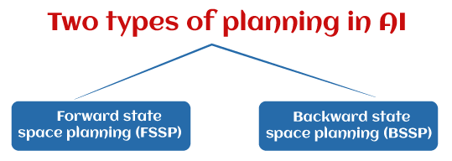
What is a Plan?
We require domain description, task specification, and goal description for any planning system. A plan is considered a sequence of actions, and each action has its preconditions that must be satisfied before it can act and some effects that can be positive or negative.
So, we have Forward State Space Planning (FSSP) and Backward State Space Planning (BSSP) at the basic level.

Slide 33
Forward State Space Planning (FSSP)
FSSP behaves in the same way as forwarding state-space search. It says that given an initial state S in any domain, we perform some necessary actions and obtain a new state S' (which also contains some new terms), called a progression. It continues until we reach the target position. Action should be taken in this matter.
Disadvantage: Large branching factor
Advantage: The algorithm is Sound

Slide 34
Backward State Space Planning (BSSP)
BSSP behaves similarly to backward state-space search. In this, we move from the target state g to the sub-goal g, tracing the previous action to achieve that goal. This process is called regression (going back to the previous goal or sub-goal). These sub-goals should also be checked for consistency. The action should be relevant in this case.
Disadvantages: not sound algorithm (sometimes inconsistency can be found)
Advantage: Small branching factor (much smaller than FSSP)
So for an efficient planning system, we need to combine the features of FSSP and BSSP, which gives rise to target stack planning which will be discussed in the next article.

Slide 35
What is planning in AI?
Planning in artificial intelligence is about decision-making actions performed by robots or computer programs to achieve a specific goal.
Execution of the plan is about choosing a sequence of tasks with a high probability of accomplishing a specific task.

Slide 36
Block-world planning problem
The block-world problem is known as the Sussmann anomaly.
The non-interlaced planners of the early 1970s were unable to solve this problem. Therefore it is considered odd.
When two sub-goals, G1 and G2, are given, a non-interleaved planner either produces a plan for G1 that is combined with a plan for G2 or vice versa.
In the block-world problem, three blocks labeled 'A', 'B', and 'C' are allowed to rest on a flat surface. The given condition is that only one block can be moved at a time to achieve the target.

Slide 37
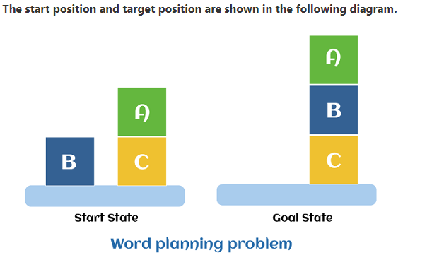

Slide 38
Components of the planning system
The plan includes the following important steps:
Choose the best rule to apply the next rule based on the best available guess.
Apply the chosen rule to calculate the new problem condition.
Find out when a solution has been found.
Detect dead ends so they can be discarded and direct system effort in more useful directions.
Find out when a near-perfect solution is found.

Slide 39
Target stack plan
It is one of the most important planning algorithms used by STRIPS.
Stacks are used in algorithms to capture the action and complete the target. A knowledge base is used to hold the current situation and actions.
A target stack is similar to a node in a search tree, where branches are created with a choice of action.

Slide 40
The important steps of the algorithm are mentioned below:
Start by pushing the original target onto the stack. Repeat this until the pile is empty. If the stack top is a mixed target, push its unsatisfied sub-targets onto the stack.
If the stack top is a single unsatisfied target, replace it with action and push the action precondition to the stack to satisfy the condition.
If the stack top is an action, pop it off the stack, execute it and replace the knowledge base with the action's effect.
If the stack top is a satisfactory target, pop it off the stack

Slide 41
First order logic
First-order logic is another way of knowledge representation in artificial intelligence. It is an extension to propositional logic.
FOL is sufficiently expressive to represent the natural language statements in a concise way.
First-order logic is also known as Predicate logic or First-order predicate logic. First-order logic is a powerful language that develops information about the objects in a more easy way and can also express the relationship between those objects.

Slide 42
First-order logic (like natural language) does not only assume that the world contains facts like propositional logic but also assumes the following things in the world:
Objects: A, B, people, numbers, colors, wars, theories, squares, pits, wumpus, ......
Relations: It can be unary relation such as: red, round, is adjacent, or n-any relation such as: the sister of, brother of, has color, comes between
Function: Father of, best friend, third inning of, end of, ......
As a natural language, first-order logic also has two main parts:
Syntax
Semantics

Slide 43
Fundamentals of First-Order Logic
First-order logic extends propositional logic by incorporating quantifiers and predicates, allowing for more expressive statements about the world.
The key components of FOL include constants, variables, predicates, functions, quantifiers, and logical connectives.
1. Constants: Constants represent specific objects within the domain of discourse. For example, in a given domain, Alice, 2, and NewYork could be constants.
2. Variables: Variables stand for unspecified objects in the domain. Commonly used symbols for variables include x, y, and z.
3. Predicates: Predicates are functions that return true or false, representing properties of objects or relationships between them. For example, Likes(Alice, Bob) indicates that Alice likes Bob, and GreaterThan(x, 2) means that x is greater than 2.
4. Functions: Functions map objects to other objects. For instance, MotherOf(x) might denote the mother of x.

Slide 44
5. Quantifiers: Quantifiers specify the scope of variables. The two main quantifiers are:
Universal Quantifier (∀): Indicates that a predicate applies to all elements in the domain.
For example, ∀x (Person(x) → Mortal(x)) means “All persons are mortal.”
Existential Quantifier (∃): Indicates that there is at least one element in the domain for which the predicate holds.
For example, ∃x (Person(x) ∧ Likes(x, IceCream)) means “There exists a person who likes ice cream.”
6. Logical Connectives: Logical connectives include conjunction (∧), disjunction (∨), implication (→), biconditional (↔), and negation (¬).
These connectives are used to form complex logical statements.

Slide 45
Syntax and Semantics of First-Order Logic
The syntax of first-order logic specifies the rules for constructing valid expressions, including terms and formulas. Terms are expressions that refer to objects and include constants, variables, and functions. Formulas are logical statements formed by combining predicates, terms, quantifiers, and logical connectives.
The semantics of FOL define the meaning of the expressions. An interpretation assigns a domain of discourse and provides meaning to the constants, functions, and predicates. A formula is considered true under an interpretation if it accurately describes the relationships and properties of the objects in the domain.

Slide 46
Applications of First-Order Logic in AI
Knowledge Representation: FOL provides a robust framework for representing complex relationships and properties of objects. For example, in a medical diagnosis system, predicates can represent symptoms, diseases, and their relationships, allowing the system to reason about potential diagnoses.
Automated Theorem Proving: Automated theorem proving involves using algorithms to prove mathematical theorems. FOL provides the foundational structure for many theorem proving systems, enabling them to verify software and hardware correctness, prove mathematical theorems, and more.
Natural Language Processing (NLP): In NLP, FOL is used to parse and understand natural language by representing the meaning of sentences in a formal, logical manner. This allows AI systems to perform tasks such as question answering, machine translation, and text summarization.
Expert Systems: Expert systems encode expert knowledge using FOL and reason about it to make decisions. For example, a legal expert system might use FOL to represent legal rules and infer outcomes based on given facts, aiding in legal decision-making processes.
Semantic Web: The Semantic Web uses FOL to describe relationships between web resources, enabling more intelligent information retrieval and processing. This enhances the ability of AI systems to understand and interact with web content.

Slide 47
Example: Using First-Order Logic for Reasoning
To illustrate the use of FOL in reasoning, consider the following knowledge base:
∀x (Cat(x) → Mammal(x)) (All cats are mammals)
∀x (Mammal(x) → Animal(x)) (All mammals are animals)
Cat(Tom) (Tom is a cat)
From these statements, we can infer:
Mammal(Tom) (Since Tom is a cat, and all cats are mammals)
Animal(Tom) (Since Tom is a mammal, and all mammals are animals)
These inferences demonstrate how FOL can be used to derive new knowledge from existing facts.
The ability to reason logically about relationships and properties is a key strength of FOL in AI.

Slide 48
Challenges and Limitations
Despite its power and expressiveness, FOL has some limitations and challenges:
Computational Complexity: Reasoning in FOL can be computationally expensive, particularly for large knowledge bases. Finding efficient algorithms for reasoning in FOL is an ongoing research area in AI.
Expressiveness vs. Decidability: While FOL is more expressive than propositional logic, it is also undecidable, meaning there is no general algorithm that can determine the truth of all FOL statements. This trade-off between expressiveness and decidability is a key consideration in AI.
Handling Uncertainty: FOL is not well-suited for handling uncertainty and probabilistic reasoning, which are common in real-world AI applications. Extensions to FOL, such as probabilistic logic and fuzzy logic, have been developed to address these limitations.

Slide 49
Knowledge base System
A knowledge-based system is a system that uses artificial intelligence techniques to store and reason with knowledge. The knowledge is typically represented in the form of rules or facts, which can be used to draw conclusions or make decisions.
One of the key benefits of a knowledge-based system is that it can help to automate decision-making processes. For example, a knowledge-based system could be used to diagnose a medical condition, by reasoning over a set of rules that describe the symptoms and possible causes of the condition.
Another benefit of knowledge-based systems is that they can be used to explain their decisions to humans. This can be useful, for example, in a customer service setting, where a knowledge-based system can help a human agent understand why a particular decision was made.
Knowledge-based systems are a type of artificial intelligence and have been used in a variety of applications including medical diagnosis, expert systems, and decision support systems.

Slide 50
Knowledge-Based System in Artificial Intelligence
An intelligent agent needs knowledge about the real world to make decisions and reasoning to act efficiently.
Knowledge-based agents are those agents who have the capability of maintaining an internal state of knowledge, reason over that knowledge, update their knowledge after observations and take action. These agents can represent the world with some formal representation and act intelligently.

Slide 51
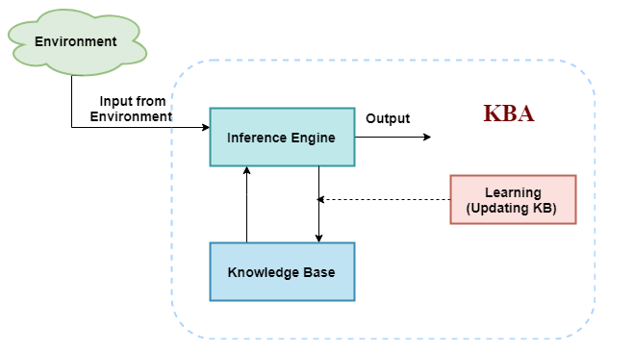
The architecture of knowledge-based agent:
The above diagram is representing a generalized architecture for a knowledge-based agent.
The knowledge-based agent (KBA) take input from the environment by perceiving the environment.
The input is taken by the inference engine of the agent and which also communicate with KB to decide as per the knowledge store in KB.
The learning element of KBA regularly updates the KB by learning new knowledge.

Slide 52
A knowledge-based agent must able to do the following:
A knowledge-based agent must able to do the following:
An agent should be able to represent states, actions, etc.
An agent Should be able to incorporate new percepts
An agent can update the internal representation of the world
An agent can deduce the internal representation of the world
An agent can deduce appropriate actions.

Slide 53
Operations Performed by KBA
Following are three operations which are performed by KBA in order to show the intelligent behavior:
TELL: This operation tells the knowledge base what it perceives from the environment.
ASK: This operation asks the knowledge base what action it should perform.
Perform: It performs the selected action.

Slide 54
The knowledge-based agent takes percept as input and returns an action as output. The agent maintains the knowledge base, KB, and it initially has some background knowledge of the real world. It also has a counter to indicate the time for the whole process, and this counter is initialized with zero.
Each time when the function is called, it performs its three operations:
Firstly it TELLs the KB what it perceives.
Secondly, it asks KB what action it should take
Third agent program TELLS the KB that which action was chosen.

Slide 55
The MAKE-PERCEPT-SENTENCE generates a sentence as setting that the agent perceived the given percept at the given time.
The MAKE-ACTION-QUERY generates a sentence to ask which action should be done at the current time.
MAKE-ACTION-SENTENCE generates a sentence which asserts that the chosen action was executed.

Slide 56
Why use a knowledge base?
A knowledge base inference is required for updating knowledge for an agent to learn with experiences and take action as per the knowledge.
Inference means deriving new sentences from old. The inference-based system allows us to add a new sentence to the knowledge base. A sentence is a proposition about the world. The inference system applies logical rules to the KB to deduce new information.
The inference system generates new facts so that an agent can update the KB. An inference system works mainly in two rules which are given:
Forward chaining
Backward chaining

Slide 57
Various levels of knowledge-based agents
A knowledge-based agent can be viewed at different levels which are given below:
1. Knowledge level
Knowledge level is the first level of knowledge-based agent, and in this level, we need to specify what the agent knows, and what the agent goals are. With these specifications, we can fix its behavior. For example, suppose an automated taxi agent needs to go from a station A to station B, and he knows the way from A to B, so this comes at the knowledge level.
2. Logical level
At this level, we understand that how the knowledge representation of knowledge is stored. At this level, sentences are encoded into different logics. At the logical level, an encoding of knowledge into logical sentences occurs. At the logical level we can expect to the automated taxi agent to reach to the destination B.

Slide 58
3. Implementation level
This is the physical representation of logic and knowledge. At the implementation level agent perform actions as per logical and knowledge level. At this level, an automated taxi agent actually implement his knowledge and logic so that he can reach to the destination.
Knowledge-based agents have explicit representation of knowledge that can be reasoned. They maintain internal state of knowledge, reason over it, update it and perform actions accordingly. These agents act intelligently according to requirements.
Knowledge based agents give the current situation in the form of sentences. They have complete knowledge of current situation of mini-world and its surroundings. These agents manipulate knowledge to infer new things at “Knowledge level”.

Slide 59
Approaches to designing a knowledge-based agent:
There are mainly two approaches to build a knowledge-based agent:
1. Declarative approach: We can create a knowledge-based agent by initializing with an empty knowledge base and telling the agent all the sentences with which we want to start with. This approach is called Declarative approach.
2. Procedural approach: In the procedural approach, we directly encode desired behavior as a program code. Which means we just need to write a program that already encodes the desired behavior or agent.
However, in the real world, a successful agent can be built by combining both declarative and procedural approaches, and declarative knowledge can often be compiled into more efficient procedural code.

Slide 60
A Logic based Financial Advisor
As a final example, let's use FOL to represent and reason about a sample problem domain: financial analysis. Although simple, it illustrates many issues involved in real applications. The function is to advise a user about whether to invest in stocks or savings.
Some investors might want to split their money. Let's say that we have determined the following rules:
Individuals with inadequate savings should make increasing savings their top priority, regardless of income.
Individuals with adequate savings and adequate income should consider stocks, which are riskier but potentially more profit.
Individuals with a lower income and already have adequate savings should split their income between savings and stocks. Our rule is to have at least $5000 in the bank for each dependent. An adequate income must be steady and supply at least $15000 per year plus $4000 for each dependent.

Slide 61
Our rule is to have at least $5000 in the bank for each dependent. An adequate income must be steady and supply at least $15000 per year plus $4000 for each dependent.
Let's start coding up some rules:
Savings_account(inadequate) → Investment(savings).
Savings_account(adequate) ^ Income(adequate)→ Investment(stocks).
Savings_account(adequate) ^ Income(inadequate) → investment(combination). Now we have to determine when savings and income are adequate or inadequate. Let's define minsavings and the adequacy of savings: MinSavings(Z) = 5000*Z
∀x Amount_saved(x) ^ ∃y (dependents(y) ^ greater(x,MinSavings(y))) → Savings_Account(adequate)
∀x Amount_saved(x) ^ ∃y (dependents(y) ^ not(greater(x,MinSavings(y))))→ Savings_Account(inadequate)
5a. ¬∃y dependents(y) → Savings_Account(adequate)

Slide 62
Now we need to define adequacy of income: MinIncome(Z) = 15000 + (4000*Z)
6. ∀x Earnings(x, steady) ^ ∃y (dependents(y) ^ greater(x,MinIncome(y))) → income(adequate).
7. ∀x Earnings(x, steady) ^ ∃y (dependents(y) ^ Not(greater(x,MinIncome(y)))) → income(inadequate).
8. ∀x Earnings(x,unsteady) → income(inadequate).
8a. ∀x Earnings(x,steady) ^ ¬∃y dependents(y) → income(adequate)

Slide 63
That's all the knowledge we need for our system.
Now let's give our system some sample data for Herman. Toiling as an instructor, Herman makes only $25000 a year.
However, he had the good fortune of inheriting some money and has $22000 saved. He has three dependents.
9. amount_saved(22000)
10. earnings(25000, steady)
11. dependents(3)

Slide 64
Programming using Prolog
Prolog stands for programming in logic. In the logic programming paradigm, prolog language is most widely available.
Prolog is a declarative language, which means that a program consists of data based on the facts and rules (Logical relationship) rather than computing how to find a solution. A logical relationship describes the relationships which hold for the given application.
To obtain the solution, the user asks a question rather than running a program. When a user asks a question, then to determine the answer, the run time system searches through the database of facts and rules.
The first Prolog was 'Marseille Prolog', which is based on work by Colmerauer. The major example of fourth-generation programming language was prolog. It supports the declarative programming paradigm.

Slide 65
In 1981, a Japanese computer Project of 5th generation was announced. After that, it was adopted Prolog as a development language. In this tutorial, the program was written in the 'Standard' Edinburgh Prolog. Prologs of PrologII family are the other kind of prologs which are descendants of Marseille Prolog.
Prolog features are 'Logical variable', which means that they behave like uniform data structure, a backtracking strategy to search for proofs, a pattern-matching facility, mathematical variable, and input and out are interchangeable.
To deduce the answer, there will be more than one way. In such case, the run time system will be asked to find another solution. To generate another solution, use the backtracking strategy. Prolog is a weakly typed language with static scope rules and dynamic type checking.
Prolog is a declarative language that means we can specify what problem we want to solve rather than how to solve it.

Slide 66
Prolog is used in some areas like database, natural language processing, artificial intelligence, but it is pretty useless in some areas like a numerical algorithm or instance graphics.
In artificial intelligence applications, prolog is used. The artificial intelligence applications can be automated reasoning systems, natural language interfaces, and expert systems. The expert system consists of an interface engine and a database of facts. The prolog's run time system provides the service of an interface engine.
A basic logic programming environment has no literal values. An identifier with upper case letters and other identifiers denote variables. Identifiers that start with lower-case letters denote data values. The basic Prolog elements are typeless. The most implementations of prolog have been enhanced to include integer value, characters, and operations. The Mechanism of prolog describes the tuples and lists.
Functional programming language and prolog have some similarities like Hugs. A logic program is used to consist of relation definition. A functional programming language is used to consist of a sequence of function definitions. Both the logical programming and functional programming rely heavily on recursive definitions.

Slide 67
Prolog Examples
The following example shows a simple program of Prolog. The program contains three components, which are known as clauses. Each clause is terminated using
dog(rottweiler).
cat(munchkin).
animal(A) :- cat(A). a full stop.

Slide 68
The following program shows another example about animals. It comprises eight clauses. The comment is shown by all the text between the /* and */.
/* Another Program of Animal */
Dog(rottweiler).
cat(sphynx). dog(poodle).
dog(bulldog). cat(bengal).
dog(dobermann).
cat(himalayan). cat(singapura).
/* This Prolog program consists of various clauses. It is always terminated using the full stop.*/

